Slide 1

DATAPROGRAMMING FINAL PROJECT
SUBMISSION BY UDAY KIRAN REDDY KOMIRELLY
STUDENT ID -200500302

Slide 2

TEAM
UDAY KIRAN REDDY KOMIRELLY
BSC ELECTRONICS

Slide 3
INTODUCTION
I took the data set of cause of death and performed analysis on data frames.
I used Plotly in python to visualise the data frame.
I took causes of death in males and females to analyse the data.

Slide 4
DATASET
The dataset contains cause of deaths in France from 2001 to 2008.
This dataset contains attributes such as TIME,GEOGRAPHY,SEX, AGE,VALUE,ICD10,UNIT.
This dataset contains 1056 records.
Source of the dataset : https://perso.telecom-paristech.fr/eagan/class/igr204/data/CausesOfDeath_France_2001-2008.csv

Slide 5

PROJECT
We used pandas to load data and perform analysis.
We used jupyter notebook to code this data.
I used SQL database to store and analyse data .

Slide 6

CREATING A DATABASE AND A TABLE AS FDEATHS

Slide 7
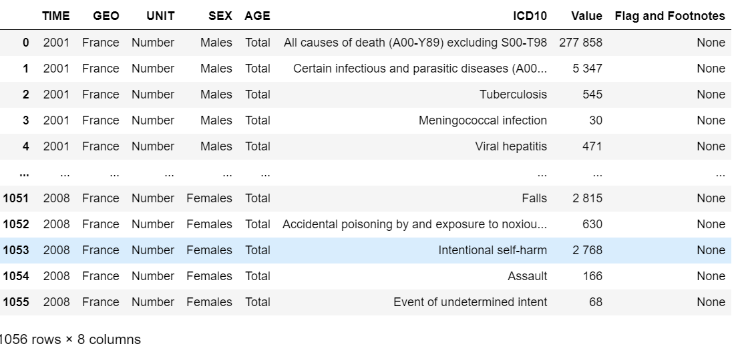
Project I created fdeaths table as shown below

Slide 8
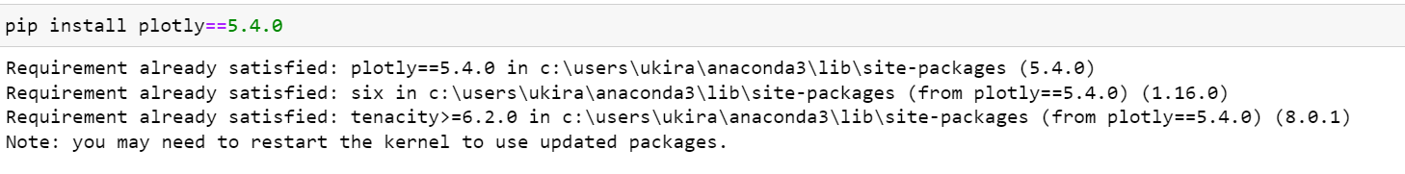
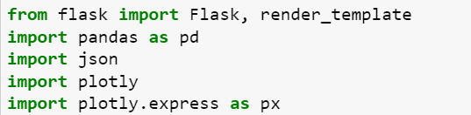
PROJECT
I used Plotly to create visuals in jupyter notebook.
I used flask framework to create a web application

Slide 9
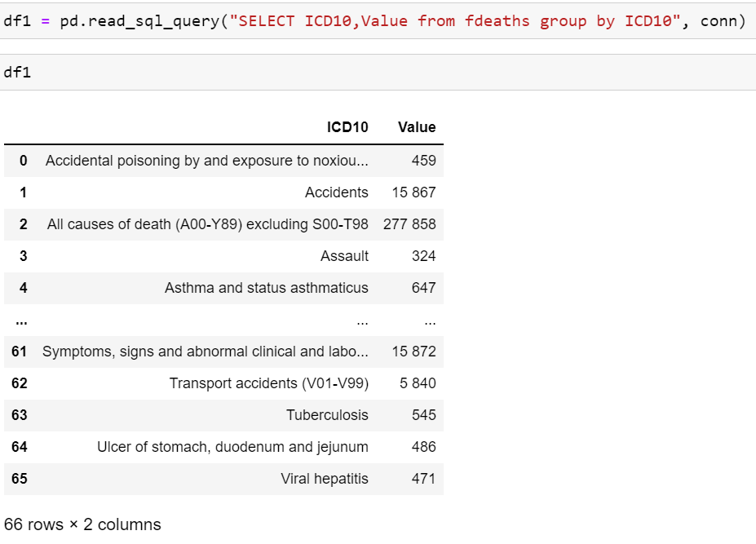
PROJECT
Selecting cause of death and no of deaths

Slide 10
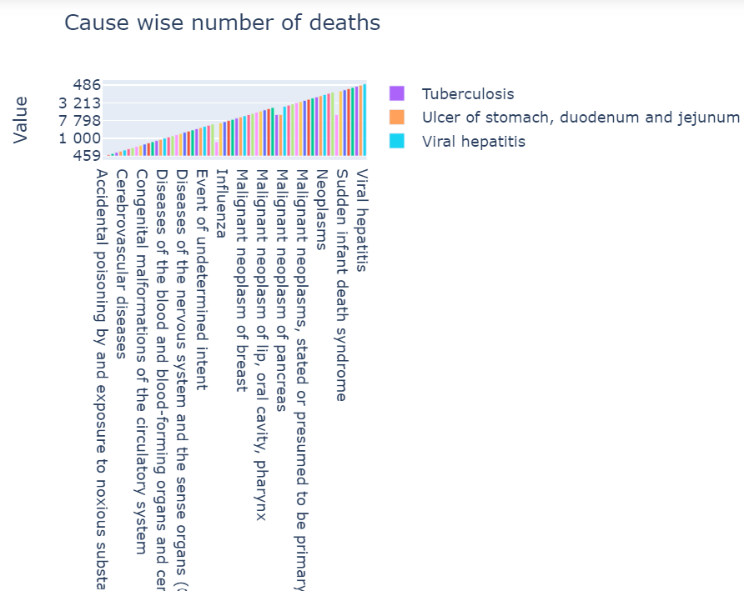
PROJECT
Chart with cause wise no of deaths

Slide 11
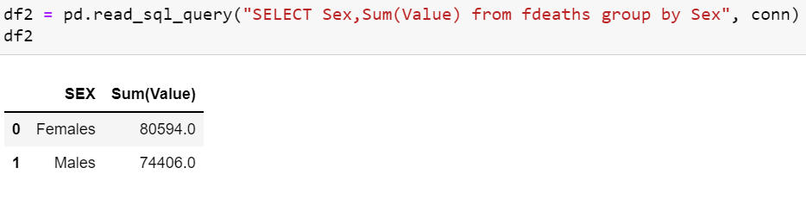
PROJECT
MALE VS FEMALE DEATHS

Slide 12
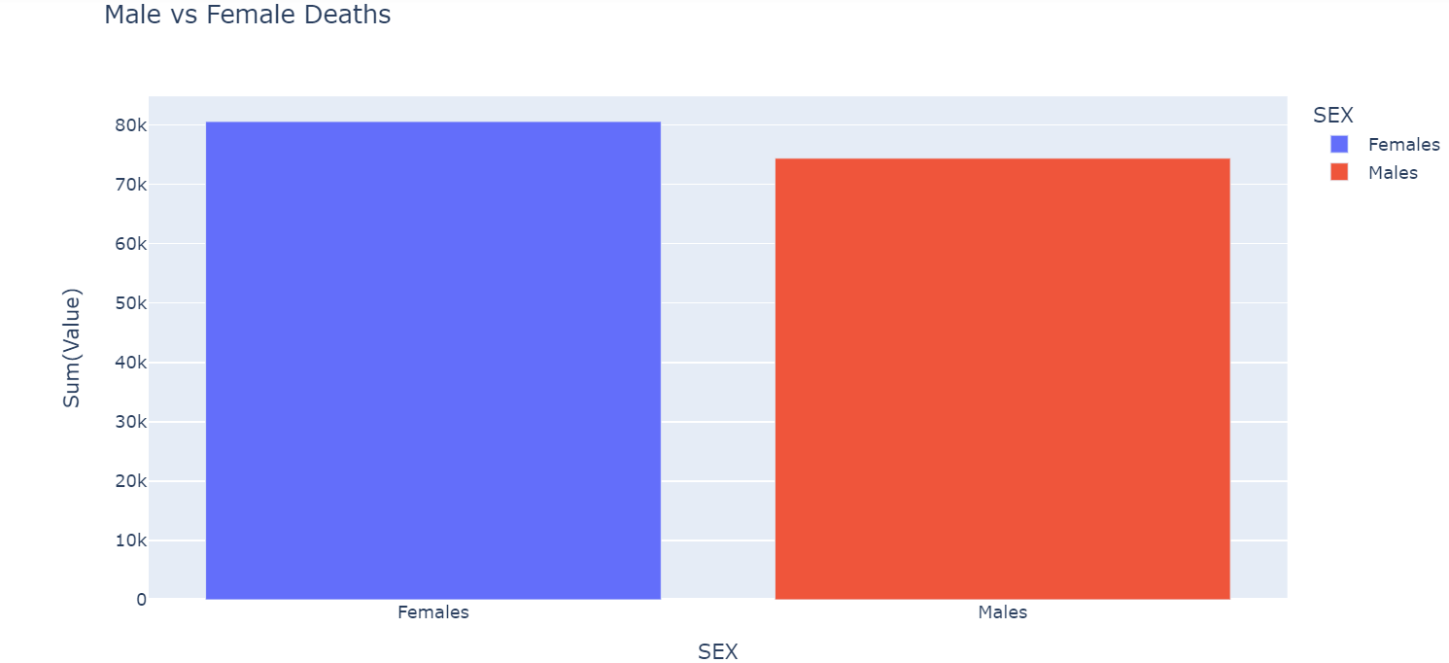
MALE VS FEMALE DEATHS CHART

Slide 13
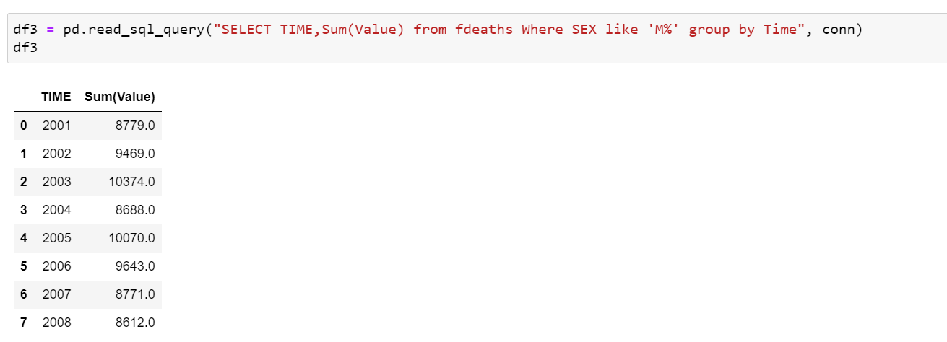
YEAR WISE DEATHS IN MALES

Slide 14
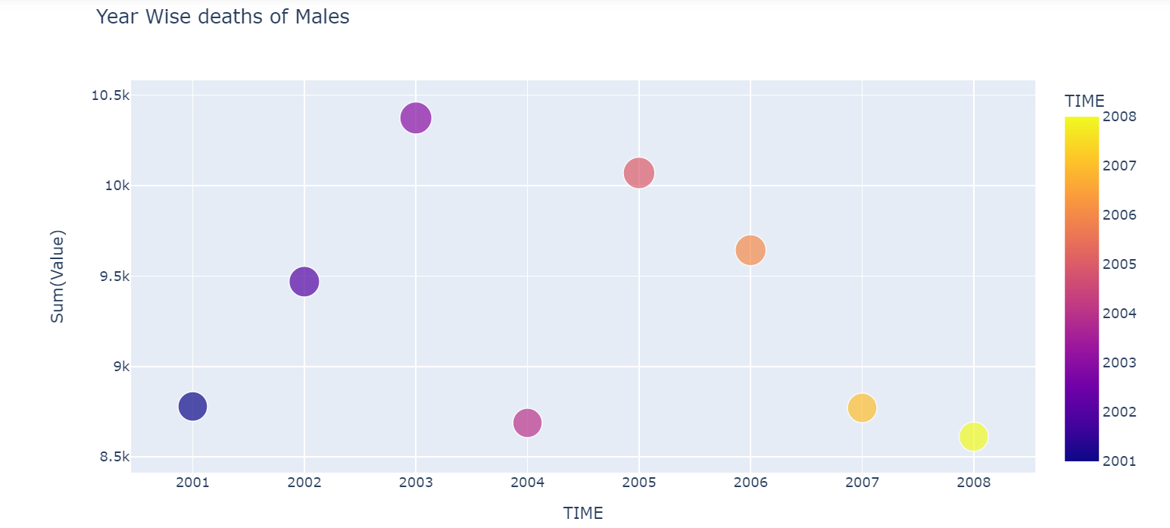
YEAR WISE DEATHS IN MALES CHART

Slide 15
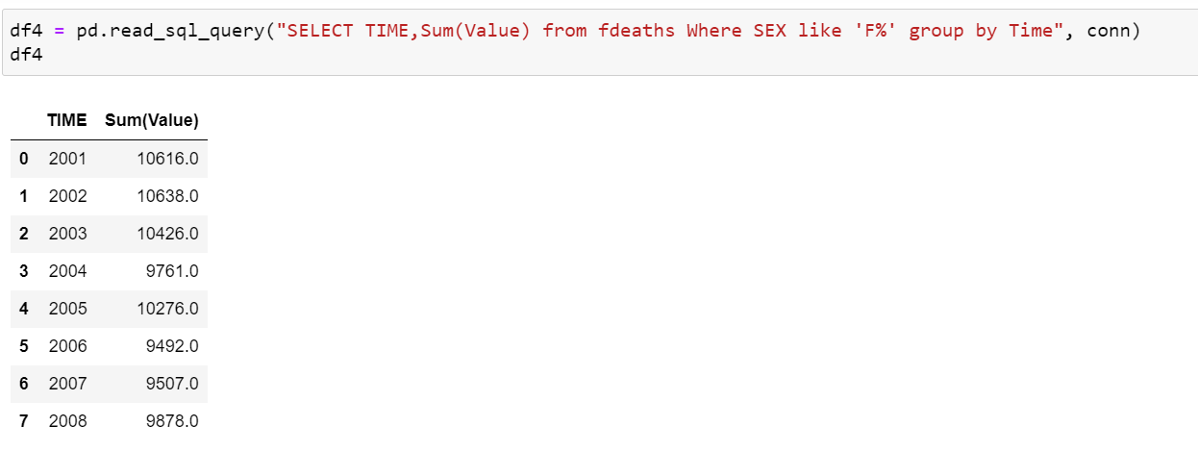
Number of females died in the years 2001-2008

Slide 16
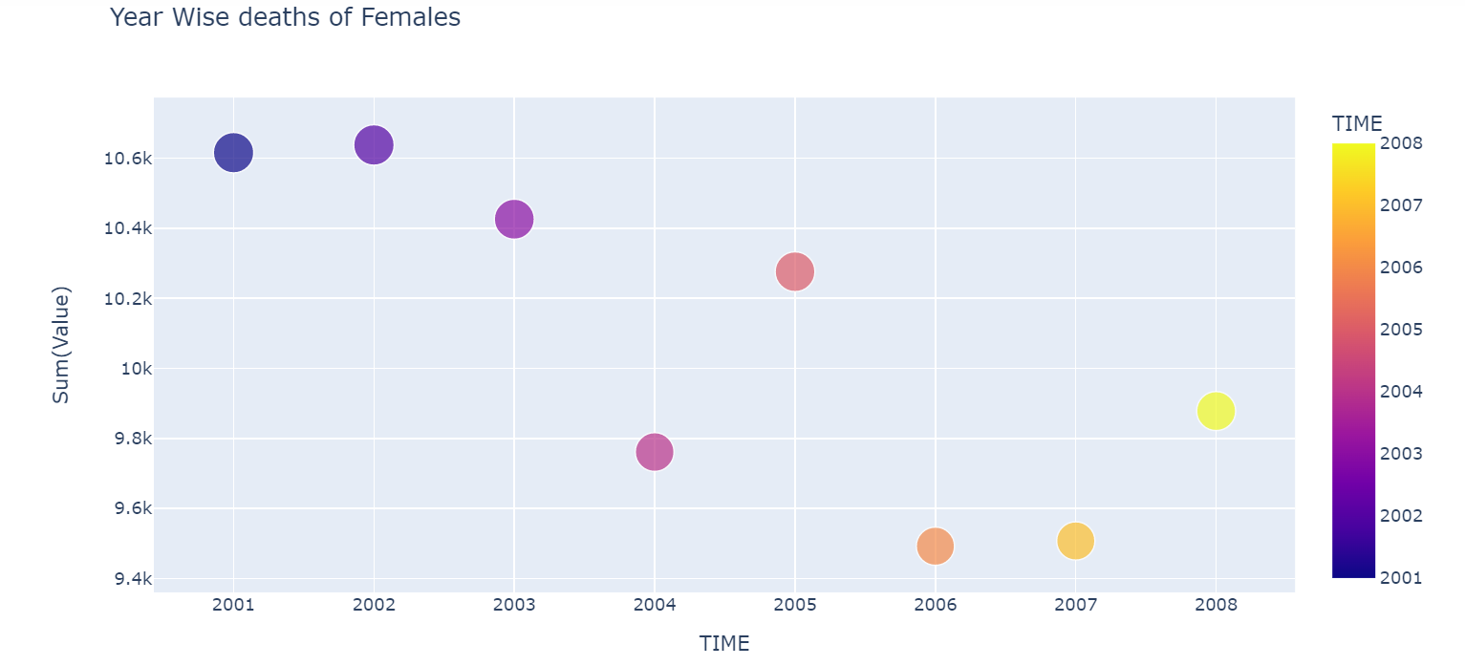
YEARWISE DEATHS OF FEMALES CHART

Slide 17
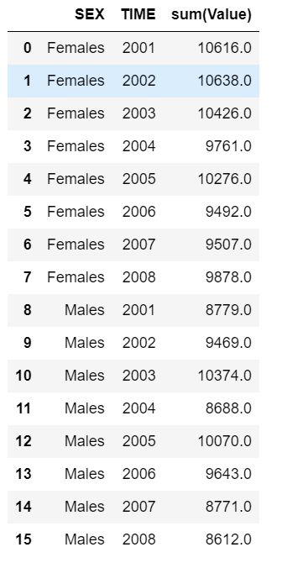
NUMBER OF FEMALES AND MALES DEAD YEARWISE

Slide 18
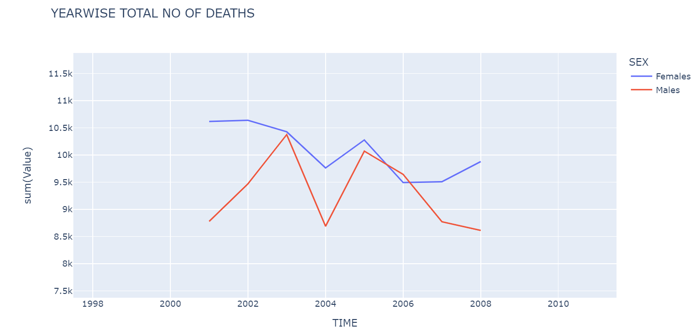
YEARWISE NO OF DEATHS IN MALES ND FEMALES

